Slide 1
Sample Slides
Lehua Hawaiian Adventures

Slide 2
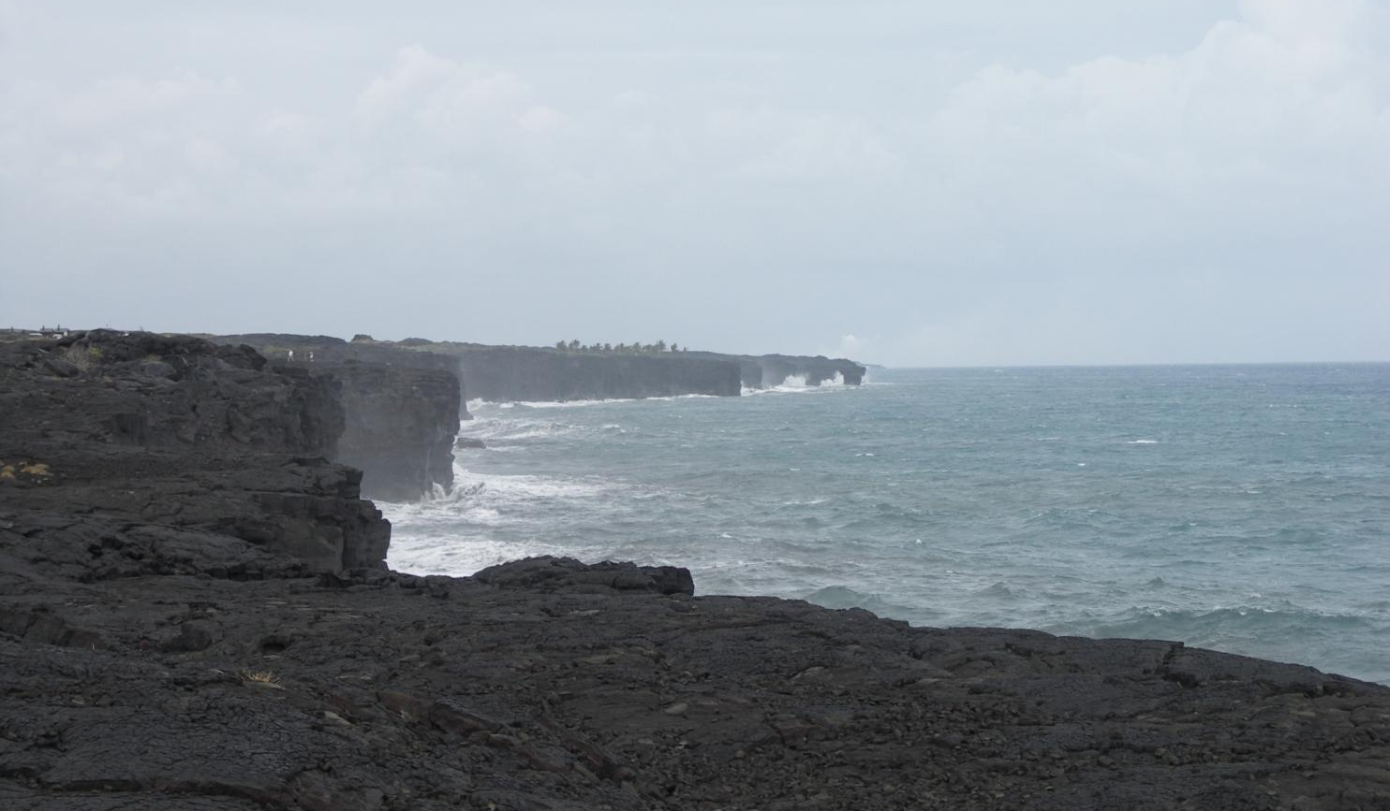
Start Your Adventure!
Contact Lehua Hawaiian Adventures for additional information.

Slide 3
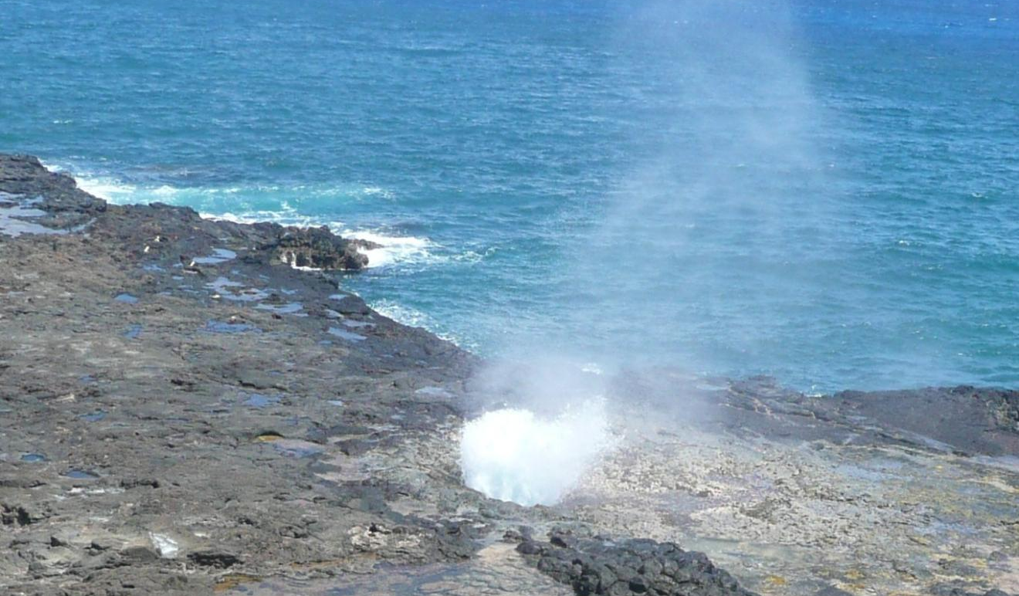
Contact Us Today!
1-800-555-4568
Lehua Hawaiian Adventures

Slide 4
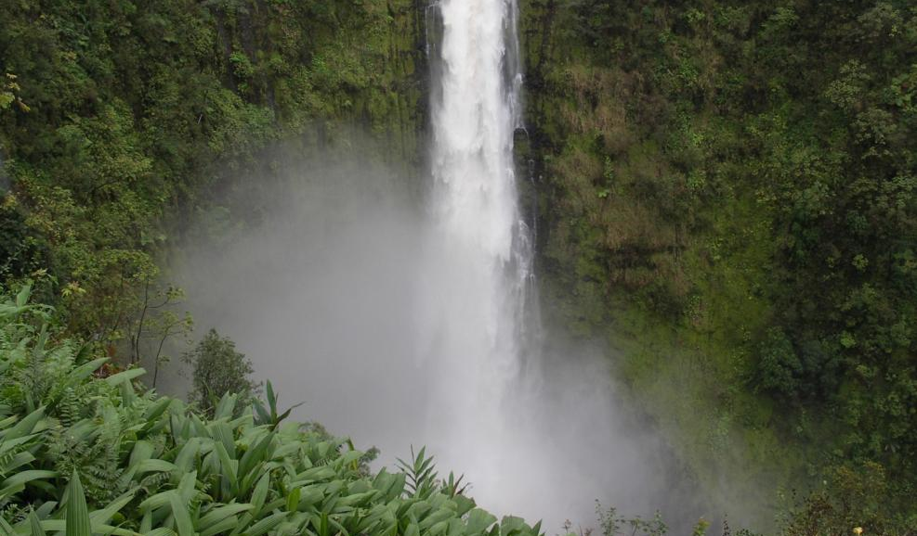
Akaka Falls
This spectacular waterfall is 422 feet high and is accessible via a short hike through Akaka State Park.

Slide 5
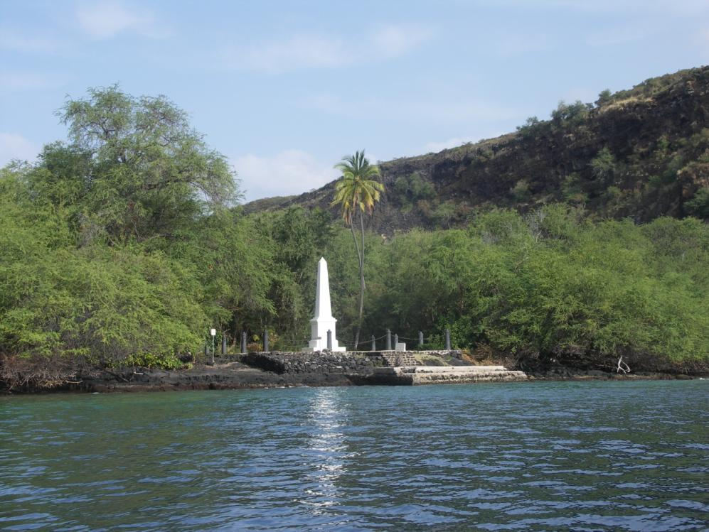
Captain Cook’s Monument

Slide 6
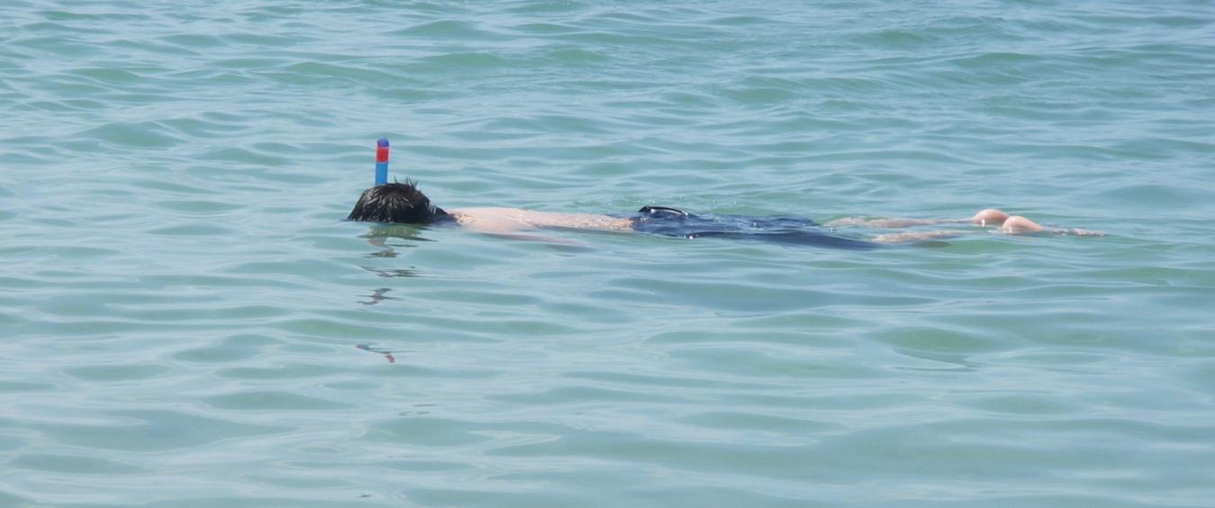
Explore the Reef!

